Slide 1
LOCATION NAME HERE

Slide 2
62 LOCATIONS. 26 COUNTRIES. 6 CONTINENTS.

Slide 3


Slide 4


Slide 5


Slide 6
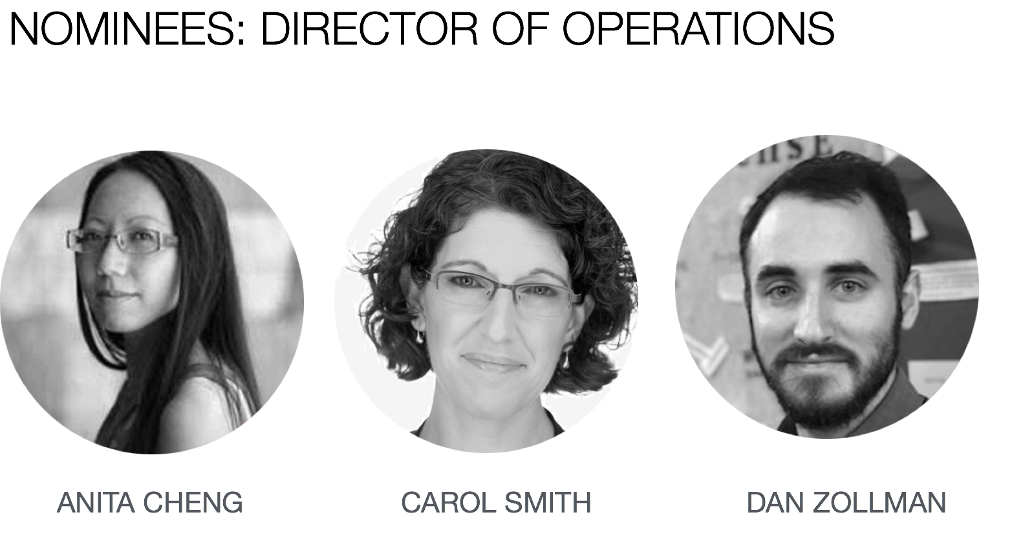

Slide 7


Slide 8


Slide 9





WIAD GLOBAL LEADERSHIP TEAM
GRACE LAU
Executive Producer
CATHERINE FLOURNOY
Social Media Director
EUGENIO MONFORTE
Regional Director,
Latin America
BRAM WESSEL
Sponsorship Director
AMY ESPINOSA
IAI Treasurer

Slide 10
WE ARE COMMITTED TO YOUR SAFETY
The Board of Directors of the Information Architecture Institute have drafted a code of conduct to be agreed to and upheld by any member of the global and local volunteer teams. This code of conduct applies to all volunteers, all locations, all attendees, and all speakers of World IA Day.
We do not tolerate harassment of participants, speakers or volunteers in any form.
WE ARE LISTENING: SAFETY@WORLDIADAY.ORG
worldiaday.org/code-of-conduct

Slide 11
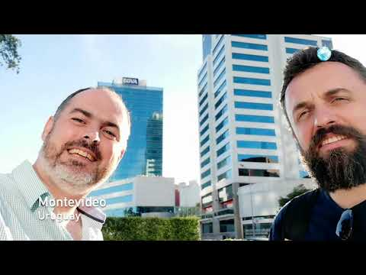


Slide 12
[ location welcome slides… ]

Slide 13
[ some other slides you
might find useful… ]

Slide 14

THANKS TO OUR LOCAL VOLUNTEER TEAM
ADD YOUR TEAM…
NAME
Title
NAME
Title
NAME
Title
NAME
Title
NAME
Title
NAME
Title

Slide 15
THANKS TO OUR LOCAL SPONSORS

Slide 16










THANKS TO OUR GLOBAL SPONSORS

Slide 17
GREAT GIVEAWAYS FOR ALL ATTENDEES AT
bit.ly/wiad19-swag
20% off any order!
Receive 20% off any purchase from Rosenfeld Media through our exclusive offer code.
60-day full featured licenses!
With this 60-day full license you can create fully-interactive high-fidelity prototypes that look exactly like your app should. No coding required.
30-day full access
With this 30-day full license, you can run both moderated and unmoderated studies on live websites and prototypes, record video, audio, heatmaps, clickstreams, survey questions and more

Slide 18

CONFERENCE DISCOUNTS
bit.ly/wiad19-swag
$50 Off Conference Registration
IA Summit takes place 13–17 March 2019 in Orlando, Florida, USA. The IA Summit is the preeminent professional conference on how to create and manage information spaces.
$50 Off Conference Registration
The EuroIA Summit takes place 26-28 Sep 2019 in Riga, Latvia. The EuroIA summit is Europe’s leading Information IA and UX conference.

Slide 19
GLOBAL PRIZES
bit.ly/wiad19-swag
65 lucky winners receives one free month to the Optimal Workshop
Optimal Workshop is a user research platform that helps you and your team make design decisions with confidence. Features include:
Tree Testing - Test the information architecture, labeling and design of your website or intranet
Card Sorting - Get robust card sort results with both remote testing and moderated research
Surveys - Slice and dice your results by looking into segments implied by answers to any discrete question
Five lucky winners will receive an annual subscription for Loop11.
Loop11 is the leading UX testing tool for running both moderated and unmoderated studies on live websites and prototypes. Features include:
Record video and audio,
Heatmaps
Clickstreams,
Survey questions and more.

Slide 20
LOCAL PRIZES
$100 off - One per location
One lucky winner receives US $100 off their Rosenfeld Media purchase
Free Axure License - One per location
One lucky winner will receive a free license for Axure.
Free proto.io 1-year freelancer plan - One per location
One lucky winner will receive a free 1-year freelancer plan for proto.io.

Slide 21
OFFICIAL HASHTAG:
#WIAD19
#DesignForDifference

Slide 22
WIFI INFO
ENTER CREDENTIALS HERE

Slide 23
TODAY’S AGENDA
XX:XX AM - XX:XX AM OPENING REMARKS BY ORGANIZER NAME
XX:XX AM - XX:XX AM SESSION 1 BY SPEAKER NAME
XX:XX AM - XX:XX AM SESSION 2 BY SPEAKER NAME
XX:XX AM - XX:XX AM SESSION 3 BY SPEAKER NAME

Slide 24
[ closing slides… ]

Slide 25
SEE YOU NEXT YEAR!
February 22, 2020

